Slide 1
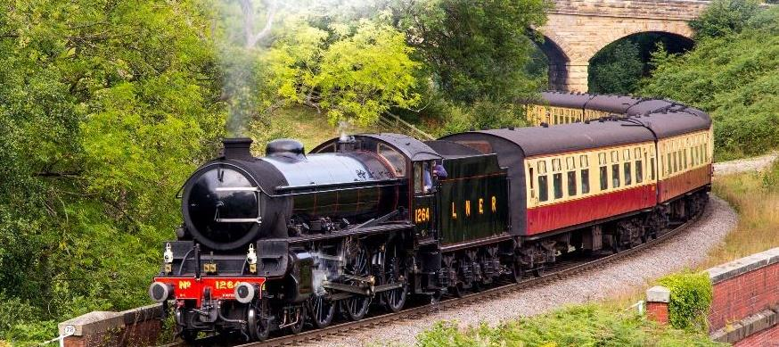

Why does Zonta Say NOW?
Magnify gender inequality
Cause global heating and extreme weather events
Increased carbon pollution
Trigger social disruption
Stops the train by taking climate action and closing the gender gaps in leadership, education, economic opportunity, health, and safety.

Slide 2
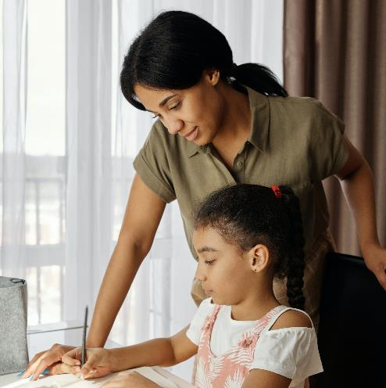
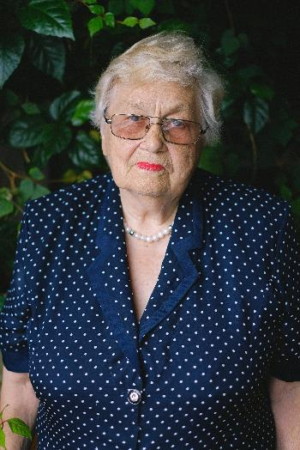
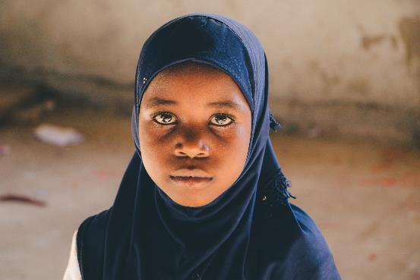
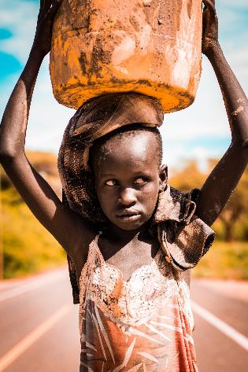
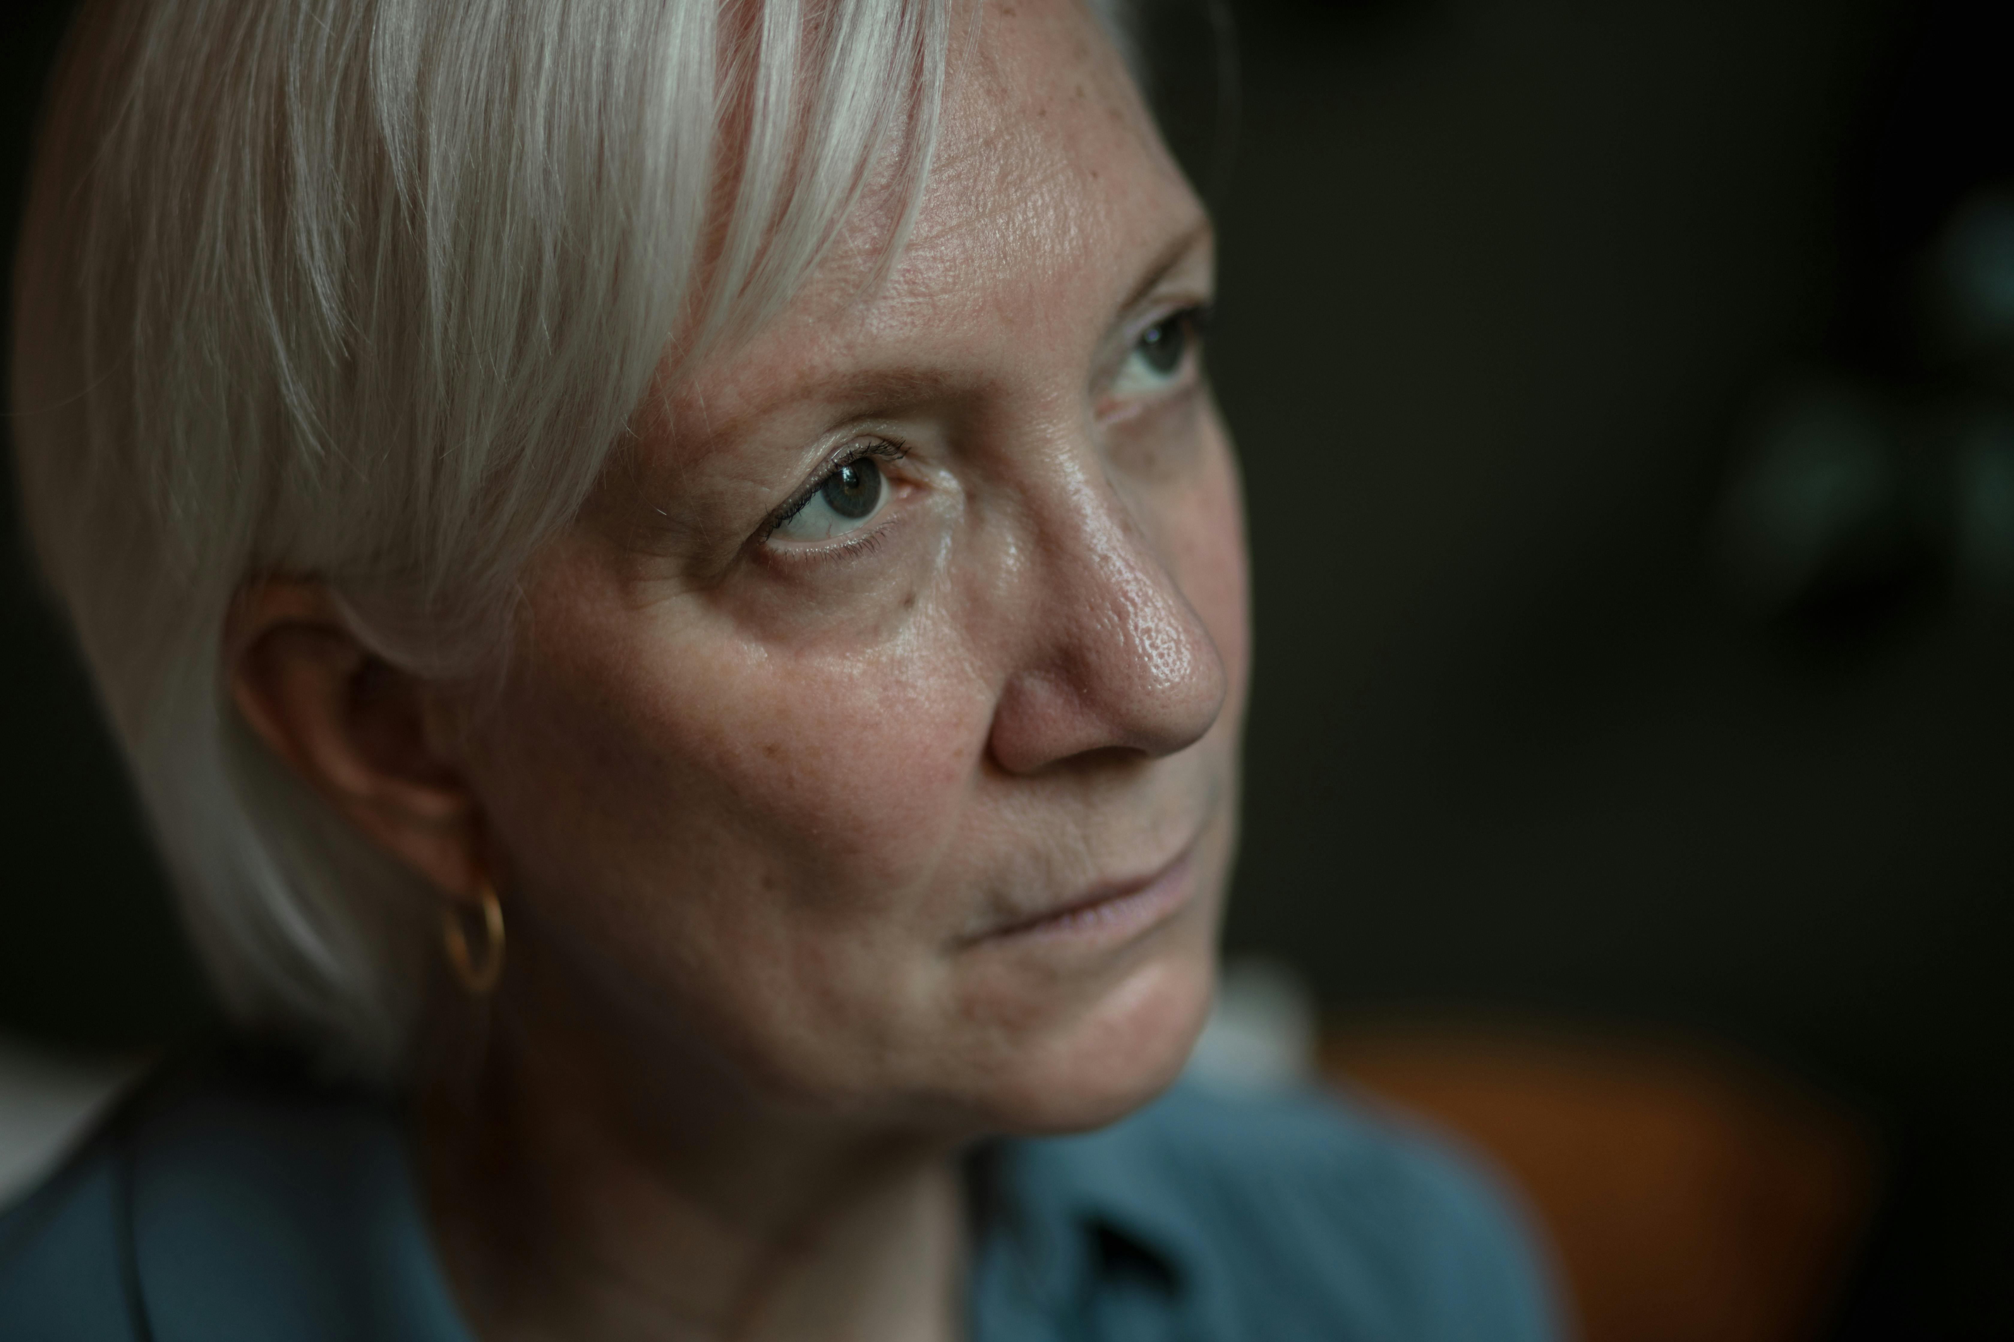
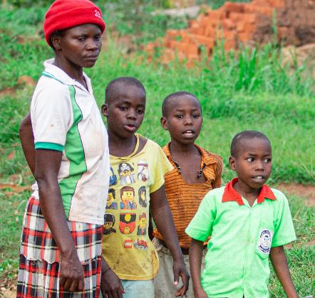
Life for women and girls at the end of the train
Aayan, 11, Mozambique
Floods led to child marriage.
Dabor, 9, Sudan
Drought means no time for school.
Judith, 42 and Clare 7, Canada
Wildfire smoke triggered Clare’s asthma. Judith may lose her casual job as she cares for Clare.
Maria, 79, Australia
Her heart condition is exacerbated in extreme heat and she cannot afford air conditioning.
Freya, 51, Germany, in temporary shelter, 2 years after floods, no money for a new home.
Ralia, 33, Nigeria
Floods destroyed the market taking away her livelihood. How will she feed her family?
Personas

Slide 3




The Statistics
1°C rise in average temperature associated with
6% rise in violence against women
10% increase or decrease in average rainfall associated with
1% rise in child marriage – when crops fail, families sell their daughters into marriage
32 million climate refugees in 2022, and this could rise to
1.2 billion by 2050
1 in 5 women who are refugees or who have been displaced because of a natural disaster has experienced sexual violence

Slide 4
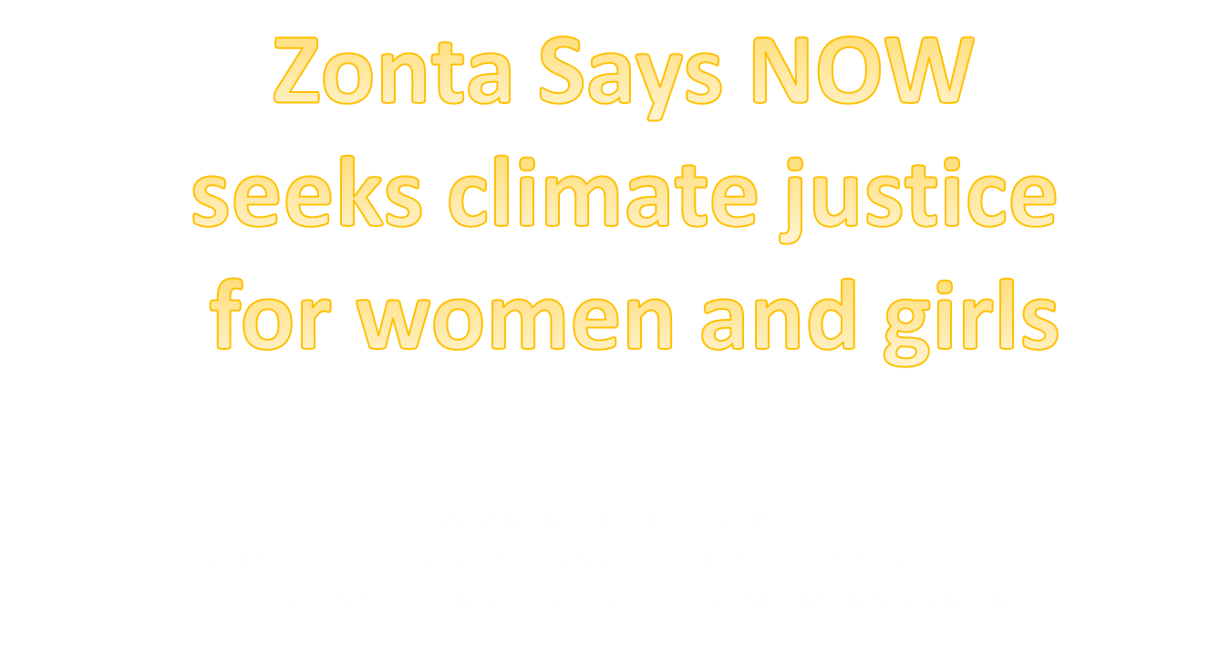
Our Purpose

